Slide 1
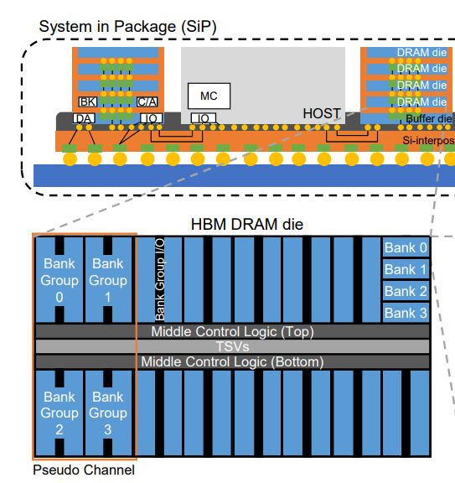
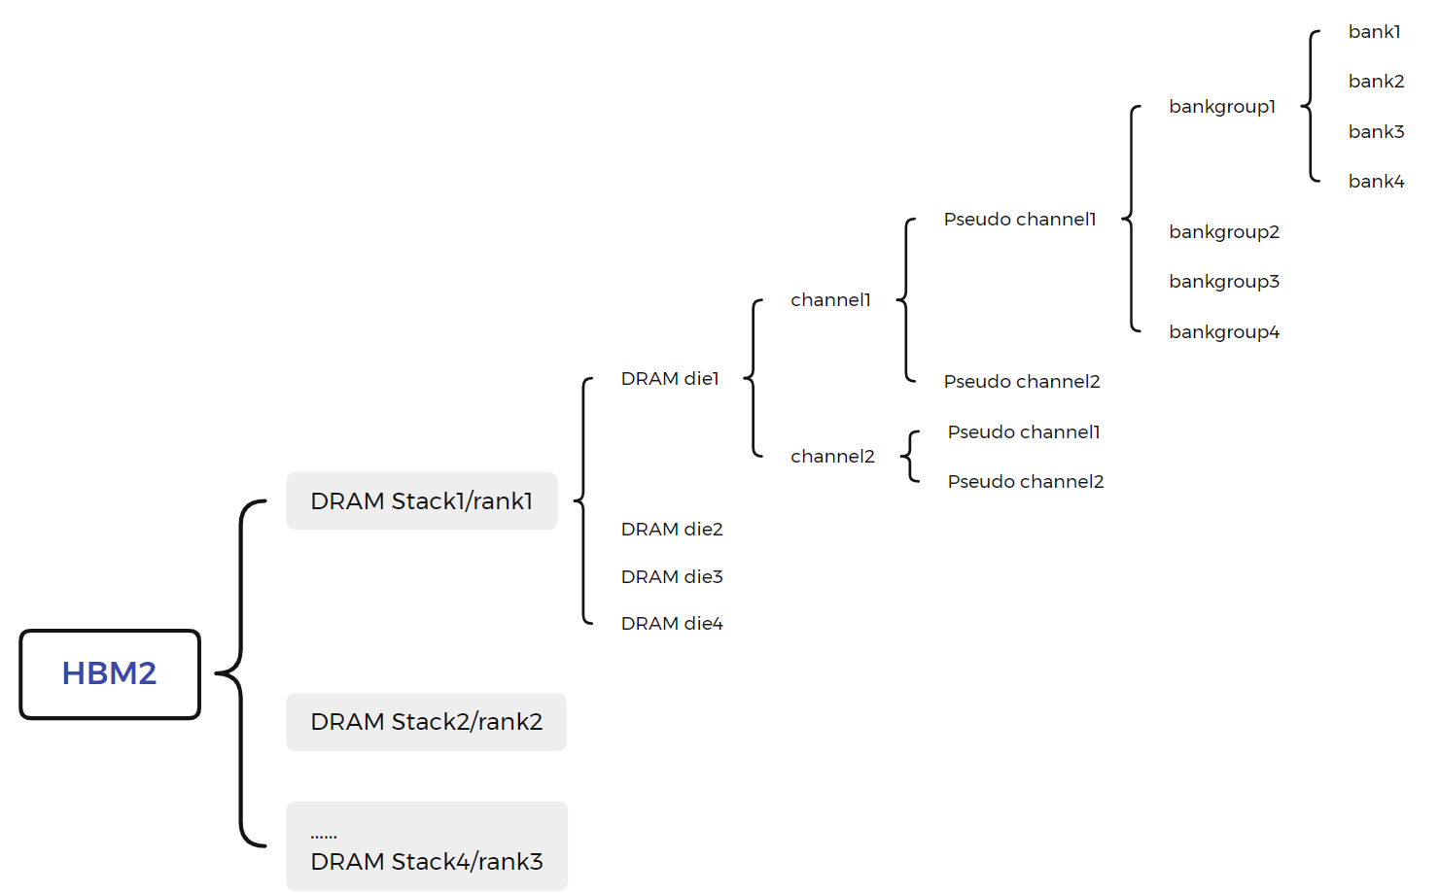
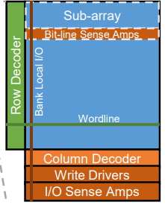
HBM-Organization

Slide 2
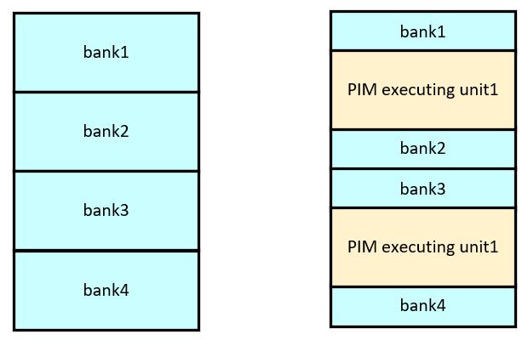
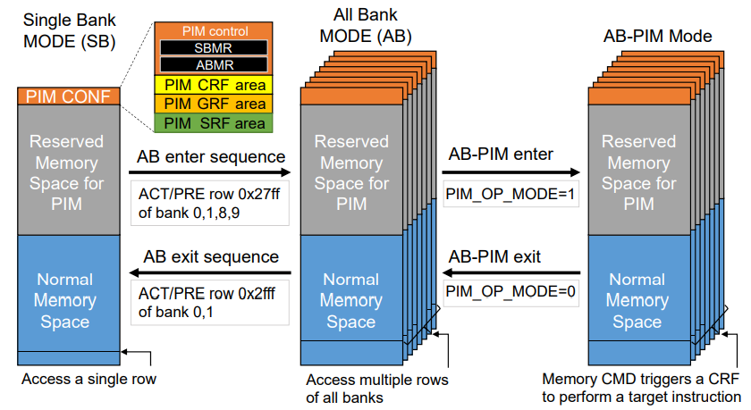
HBM-Bandwidth
Adopt DDR technique, the transfer rate of a Pch is 128bit/s.
A pCH has 16 bank and a DRAM stack has 16 pCH.
Under 1GHz, the bandwidth:
16 * 16/2 * 256bit/s * 1GHz /8 /2 = 1TB/s
(pCH number * bank number * frequency/time latecy)

Slide 3
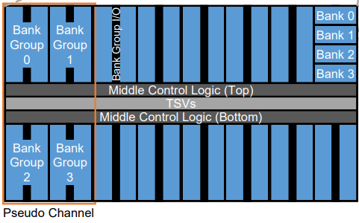
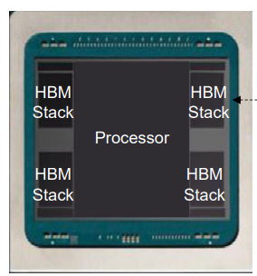
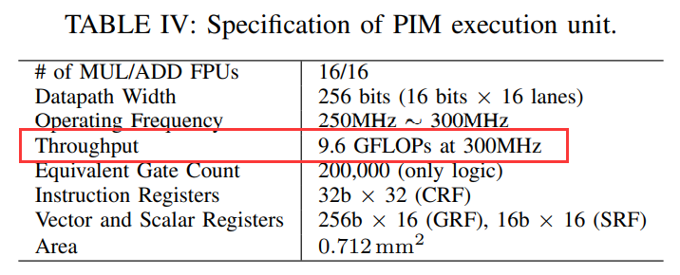
HBM-Throughput
A PIM-DRAM stack has 4*4*4*2= 128 PIM execution unit and a chip has 4 DRAM-PIM stack, so the overall throughput is :
9.6 * 128 * 4 = 4915.2 GFLOPs
CPU-Intel xeon 6226r’s throughput : 3696GFLOPS
GPU-Tesla A100’s throughput : 312000/624000GFLOPs(40GB/s PCLe / 80GB/s PCLe)

Slide 4
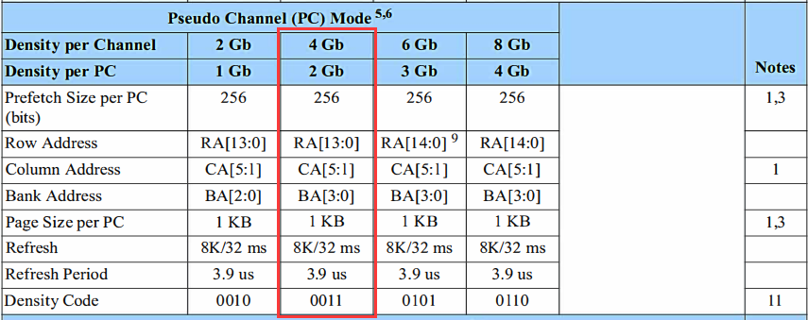
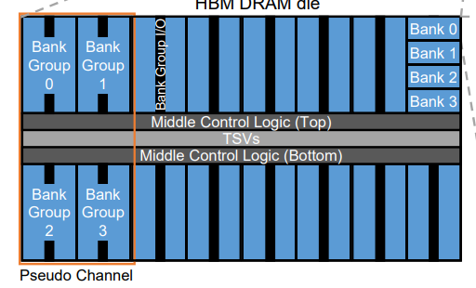
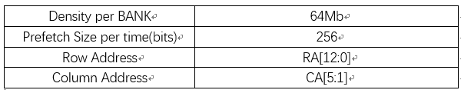
HBM-Addressing
Traditional HBM
2Gb = ${2^{8}∗2}^{14}∗2^{5}∗2^{4}$
PIM-HBM
64Mb = ${2^{8}∗2}^{13}∗2^{5}$

Slide 5
CoNDA: Efficient Cache Coherence Support for Near-Data Accelerators
Conference : ISCA-2019
Author : Amirali Boroumand,Saugata Ghose,Minesh Patel,Hasan Hassan……
Research unit : Carnegie Mellon University, Samsung Semiconductor, Inc……

Slide 6
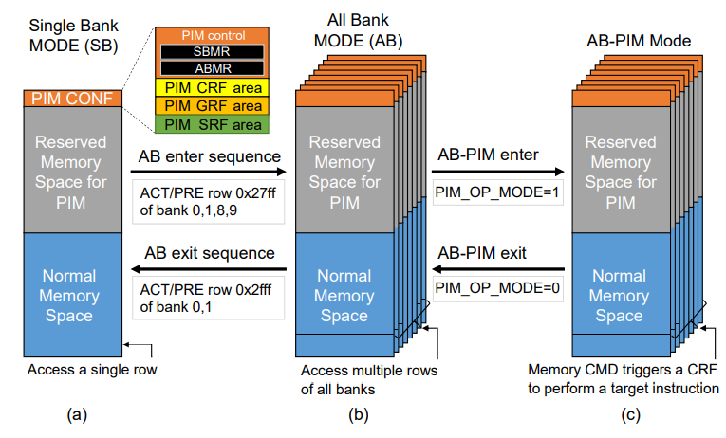
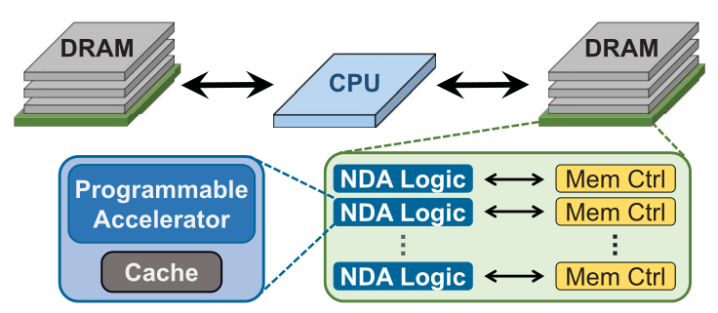
Research work—Background
Near-data accelerators(NDA) improve the energy efficiency and performance of computing systems.
HMC HBM
The lack of an efficient coherence mechanism to synchronize data updates between CPUs and NDAs.
NDA applications typically suffer from poor locality and incur a large number of coherence miss so generate a large amount of off-chip data movement.
The energy and performance costs of off-chip communication between NDAs and CPUs are very high.

Slide 7
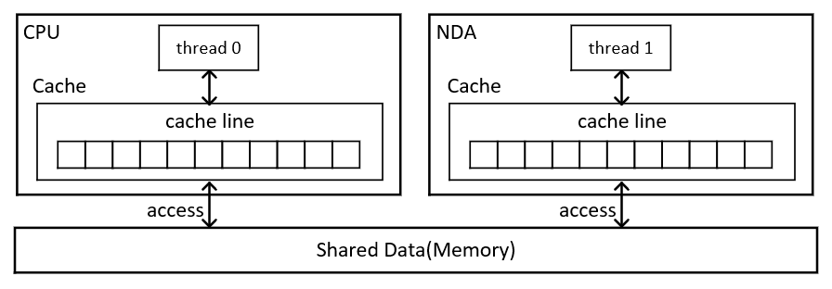
Research work—Problem
Recent proposed some NDA-CPU coherence mechanisms only suit for some applications.
These mechanisms assume that CPU and NDA share only a limited amount data.
Some applications like graph processing frameworks and hybrid in-memory databases are not suit for the above condition.
Not all portions of these applications benefit from being executed on the NDA, and the portions that remain
on the CPU often concurrently access the same region of data.
(1) Multithreaded graph processing frameworks.
a. Multiple threads operate in parallel on the same shared graph each thread executes a graph algorithm.
(2) Hybrid transactional/analytical processing(HTAP) database.
a. The analytical queries are well-suited for NDA execution.
b. The transactional queries are well-suited for CPU.

Slide 8
Research work—Motivation
To understand the characteristics of sharing, authors delve further into the memory access patterns of the CPU threads and NDA kernels find that:
While CPU threads and NDA kernels share the same data regions, they typically do not collide concurrently on the same cache lines.
In the rare case of collisions, the CPU threads only read those cache lines, meaning that they rarely update the same data that an NDA is actively working on.
If the coherence mechanism has insight into what part of the shared data is actually accessed by NDA kernels and CPU threads, much of the unnecessary off-chip coherence traffic can be eliminated .

Slide 9
Research work—Solution
Propose Coherence for Near-Data Accelerators (CoNDA), a mechanism that lets the NDA optimistically start execution assuming that it has coherence permissions, without issuing any coherence messages off-chip.

Slide 10
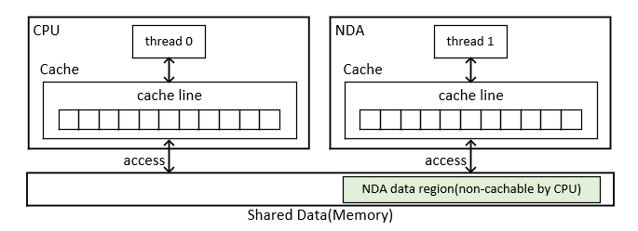
Research work—Preliminaries
Analysis of NDA Coherence Mechanisms.
Non-Cacheable Approach.
(1) Marking any data accessed by the NDA non-cacheable by the CPU.
(2) Advantage:
1) Any CPU write are visible to NDA immediately.
2) It works well when CPU rarely access the NDA data region.
(3)Disadvantage:
1) It performs poorly for many application when CPU access the NDA data region often.

Slide 11
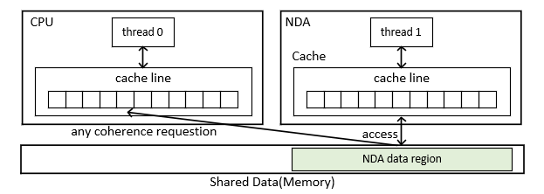
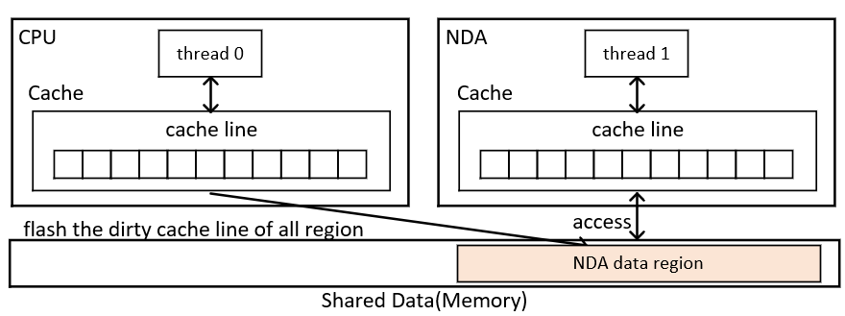
Research work—Preliminaries
Analysis of NDA Coherence Mechanisms.
Coarse-Grained Coherence.
(1) A single coherence permission applies to the entire NDA region, and the CPU must flush all dirty cache lines in the NDA data region every time an NDA acquires coherence permissions for the region, even if the NDA does not access most of the data in the region .
(2) Advantage:
1) It works well when there is only a limited amount of data shared by CPU threads and NDA kernel.
(3) Disadvantage:
1) It results a significant unnecessary data movement between CPU and NDA and incurs high overhead.

Slide 12
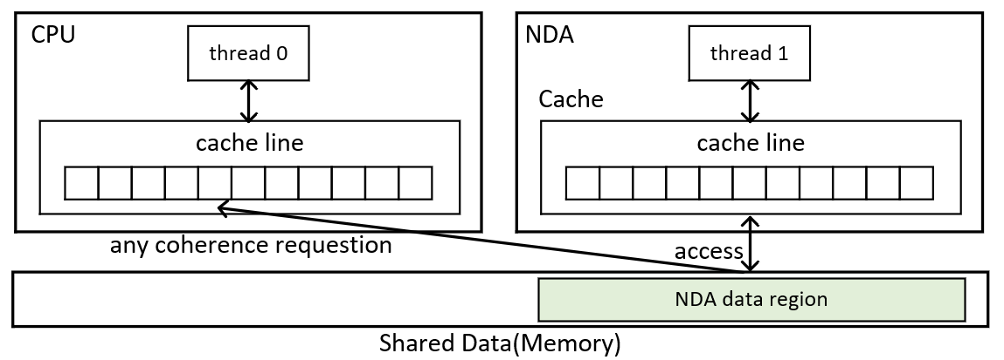
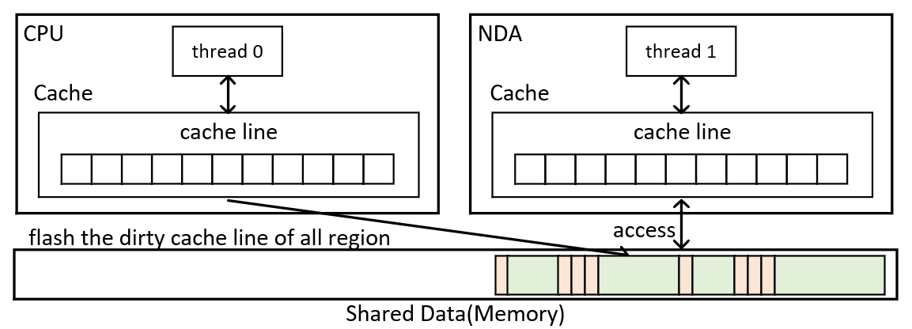
Research work—Preliminaries
Analysis of NDA Coherence Mechanisms.
Fine-Grained Coherence.
(1) Advantage:
2) Fine-grained coherence acquires coherence permissions for only the pointers that are actually traversed during pointer chasing.
1) It can ease programmer effort when developing applications for NDAs, as multithreaded programs already use this programming model..
(2) Disadvantage:
1) It has to exchange coherence messages for every cache miss and NDA kernels exhibits poor temporal locality so the message exchange generates large amount of off-chip data movement..

Slide 13
Research work—Technique
OPTIMISTIC NDA EXECUTION.
Most of off-chip data movement generated by existing coherence mechanism can be eliminated if the mechanism knows what part of the shared data is actually assessed.

Slide 14
Research work—Technique
Execution Model .
The NDA executes in optimistic mode assumes that it always has coherence permissions on the cache lines that it uses, without checking the CPU coherence directory.
When optimistic execution stops, the system must determine whether it can commit the data updates optimistic execution.
(1) All memory updates by the NDA are treated as if they all occur when optimistic stops.
(2) For all memory operations which CPU threads and NDA kernel execute concurrently, the CPU thread memory operations are effectively ordered before the NDA memory operations.
(3) If no violation occurred, the NDA commits the updates.
(4) If there are violations, the NDA must perform the necessary coherence operations and re-execute the optimistically-executed code.
(5) Because CPU and NDA rarely access the same cache line, re-execution happens rarely.

Slide 15
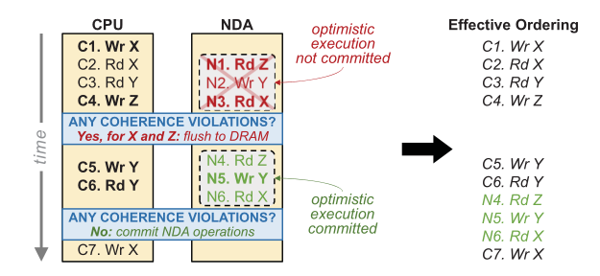
Research work—Technique
Identify Necessary Coherence Requests.
NDA Read and CPU Write(to the same cache line).
(1) This case triggers re-execution.
(2) Any CPU memory accessed are ordered before any NDA memory access.
(3) CPU may perform the write before memory optimistic execution begins and this still requires re-execution if the updated cache line is not written back to memory before the NDA performs read.
NDA Write and CPU Read(to the same cache line).
(1) This case does not triggers re-execution.
(2) Any read to a cache line by the CPU is ordered before the NDA’s write to the same cache line.

Slide 16
Research work—Technique
Identify Necessary Coherence Requests.
NDA Write and CPU Read(to the same cache line).
(1) This case does not triggers re-execution.
(2) When the NDA is ready to commit its updates, it cannot simply flush the old cache line in the CPU because the CPU and the NDA may have written to different word in the same cache line.

Slide 17
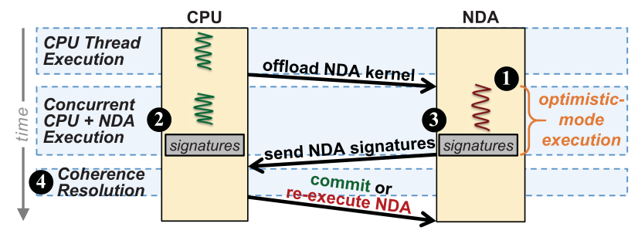
Research work—Technique
Coherence for Near-data Accelerators, an efficient coherence mechanism that makes use of optimistic NDA execution.
CoNDA Architecture.
(1) When an application wants to launch an NDA kernel, the NDA begins executing the kernel in optimistic mode.
(2) While the NDA kernel executes, all CPU execute normally.
(3) CoNDA efficiently tracks the addresses of all NDA reads, NDA writes, and CPU writes.
(4) When optimistic execution is done, CoNDA attempts to resolve coherence. The NDA transmits its signatures to the CPU, and CoNDA compares the NDA signatures with the CPU signatures to identify the necessary coherence requests.
(5) If CoNDA detects any coherence violation.
(1) The NDA invalidates all of its uncommitted updates;
(2) The CPU resolves the coherence requests, performing only the necessary coherence operations;
(3) The NDA re-executes the uncommitted portion of the kernel.
(6) Otherwise, CoNDA updates the data or resumes optimistic execution if the NDA kernel is not finished.

Slide 18
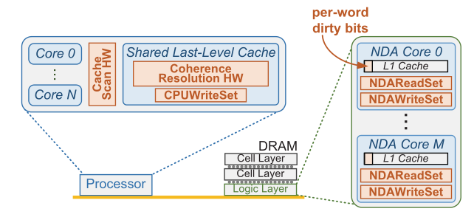
Research work—Technique
Signature.
CoNDA uses signatures to track whether any coherence requests are necessary during optimistic execution.
Tracking memory operations during NDA execution.
(1) CoNDA maintains three sets of signatures:
1). NDAReadSet records the addresses of all cache lines read from by the NDA.
2). NDAWriteSet records the addresses of all cache lines written to by the NDA.
3). The CPUWriteSet records the addresses of all cache lines in the NDA data region that
A. a CPU thread writes to during optimistic execution.
B. have dirty copies in a CPU cache before an NDA kernel starts.

Slide 19
Research work—Technique
Signature.
CoNDA uses signatures to track whether any coherence requests are necessary during optimistic execution.
Tracking memory operations during NDA execution.
Implementation
(1) Each segment in the signature employs a unique hash function. When an address is added to the signature, each segment’s hash function maps the address to a single bit in the segment, named hashed value and the bit is set to 1.
(2) Using this function, the CoNDA can quickly compare two filters to see if both filters might contain one or more of the same addresses by taking the bitwise AND of the two signatures.
(3) Due to aliasing of some hashed values, Bloom filters can introduce a limited number of false positives.

Slide 20
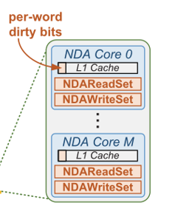
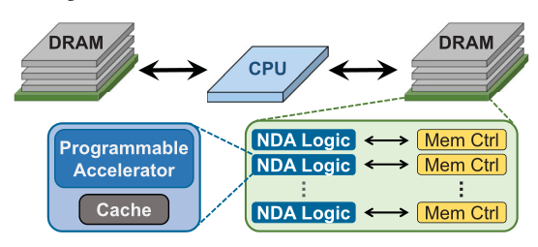
Research work—Technique
Signature.
CoNDA uses signatures to track whether any coherence requests are necessary during optimistic execution.
Implementation.
Tracking memory operations during NDA execution.
Signature Size.
(1) The NDAReadSet and NDAWriteSet each use one 256 B register that is split into four segments.
(2) The CPUWriteSet uses eight 256 B Bloom filters.
(3) It can hold up to 250 addresses in each 256 B filter.
Buffering Unconnected Values.
NDA buffers the updated data value in the L1 cache, add a per-word dirty bit mask to each cache line to mark all
uncommitted data updates.

Slide 21
Research work—Technique
Ending Optimistic NDA execution.
Execution in optimistic mode stops when one of three events occurs:
(1) The NDA reaches the end of the NDA kernel.
(2) The NDA L1 data cache needs to evict a speculative cache line.
(3) One of the signatures cannot hold more addresses without exceeding the false positive rate.
Identifying Necessary Coherence Requests.
Once optimistic execution ends, CoNDA uses the signatures to check for and resolve any necessary coherence operations, and attempts to commit any uncommitted NDA data updates.
Calculating the intersection of the NDAReadSet and the CPUWriteSet and there are two cases:
(1) Conflict - NDA read and CPU write.
1) CPU flushes any dirty cache lines that match addresses in the NDAReadSet to DRAM and places a copy of these cache lines in the NDA L1 cache.
2) The coherence sends a message to the NDA that the commit attempt failed.
3) The NDA invalidates all uncommitted data in its L1 cache, rolls back to its checkpointed state, and restarts optimistic execution.

Slide 22
Research work—Technique
Identifying Necessary Coherence Requests.
Once optimistic execution ends, CoNDA uses the signatures to check for and resolve any necessary coherence operations, and attempts to commit any uncommitted NDA data updates.
Calculating the intersection of the NDAReadSet and the CPUWriteSet and there are two cases:
(1) Conflict:
(2) No conflict - NDA write and CPU read & NDA write and CPU write
1) Computing the intersection of the NDAWriteSet and the CPUWriteSet to find the overlap.
2) CoNDA identifies which cache lines need to be merged and sends these cache lines to the NDA for merging.
3) All cache lines in the CPU cache that match an address in the NDAWriteSet are invalidated.
4) Clearing the uncommitted flag on all NDA cache lines and allows the lines to be written to DRAM.
5) If the NDA kernel is not finished, the NDA continues executing the kernel by starting optimistic execution.

Slide 23
Research work—Evaluation
Methodology.
Simulator
(1) Implement CoNDA in gem5 simulator and perform all simulations in full-system mode using the x86 ISA.
(2) Using DRAMSim2 DRAM timing simulator to model 3D-stacked HMC DRAM.
Application1 : graph
(1) Three graph application from Ligra(a light weight multithreaded graph framework).
1) Connected Components(CC)
2) Radii
3) PageRank(PK)
(2) Two kind of input graphs.
1) Enron email communication network (73384 nodes, 367662 edges)-modest graph.
2) ArXiv General Relativity (10484 nodes, 28984 edges) -modest graph.
3) Peer-to-peer Gnutella25 (45374 nodes, 109410 edges)-modest graph.
4) the Amazon product network (334863 nodes, 925872 edges)-large graph.
5) the DBLP collaboration network (317080 nodes, 1049866 edges)-large graph.
Application2 : Hybrid transactional/analytical processing(HTAP) database.
(1) Analytical workloads consist of 128 or 256 or 1024analytical queries (HTAP-128 and HTAP-256 and HTAP-1024) that use the select and join operations.

Slide 24
Research work—Evaluation
Methodology.
Identifying NDA kernels in Applications.
(1) It is memory intensive (i.e., its LLC misses per kilo instruction, or MPKI, is greater than 20).
(2) The majority of the function’s execution time is spent on data movement.
(3) It is one of the top three functions in the workload in terms of execution time.
In Ligra applications select the edgeMap function as an NDA kernel. This function processes and updates a subset of edges for each vertex, which generates many random memory accesses.
In HTAP workloads select the analytical queries (i.e., select and join operations) as NDA kernels.

Slide 25
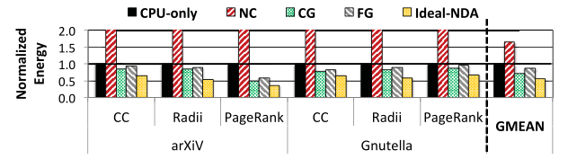
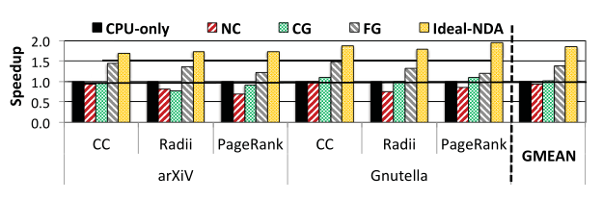
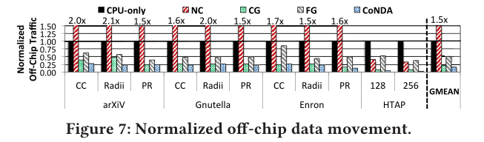
Research work—Evaluation
Analysis of NDA Coherence Mechanisms.
ideal NDA mechanism that incurs no penalty for coherence.
Off-Chip Data Movement.
(1) NDA coherence mechanisms, with an average reduction of 30.9% over the next best mechanism, CG.
(2) NC’s data movement is very high because all processor accesses to the NDA data region must go to DRAM.
(3) CoNDA reduces data movement by 86.3% over CPU-only, because it successfully allows memory-intensive portions of the applications to no longer consume off-chip bandwidth.

Slide 26
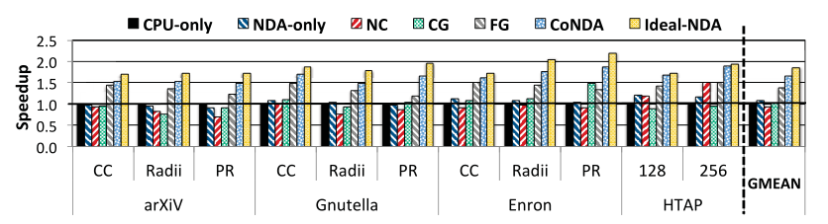
Research work—Evaluation
Performance.
(1) Ideal-NDA shows that there is significant potential for speedup (on average 1.84x) than NDAs.
(2) CoNDA improves performance over CPU-only by 66.0%, and over the best previous mechanism, FG, by 19.6%.
(3) CoNDA performs 51.7% better than NDA-only, and NDA-only performs only 8.7% better than CPU-only.
(4) Executing applications entirely on NDAs eliminating on average 82.2% of Ideal-NDA’s performance improvement.
(5) CoNDA’s execution time consists of three major parts:
1) NDA kernel execution(88.3%).
2) Coherence resolution overhead(3.3%).
3) Re-execution overhead(8.4).

Slide 27
Research work—Evaluation
Performance.
(1) Ideal-NDA shows that there is significant potential for speedup (on average 1.84x) than NDAs.
(2) CoNDA improves performance over CPU-only by 66.0%, and over the best previous mechanism, FG, by 19.6%.
(3) CoNDA performs 51.7% better than NDA-only, and NDA-only performs only 8.7% better than CPU-only.
(4) Executing applications entirely on NDAs eliminating on average 82.2% of Ideal-NDA’s performance improvement.
(5) CoNDA’s execution time consists of three major parts:
1) NDA kernel execution(88.3%).
2) Coherence resolution overhead(3.3%).
3) Re-execution overhead(8.4%).
a. The collision rate is low(13.4% on everage)
b. The re-execution of the NDA kernel portion is significantly faster than its original execution.

Slide 28
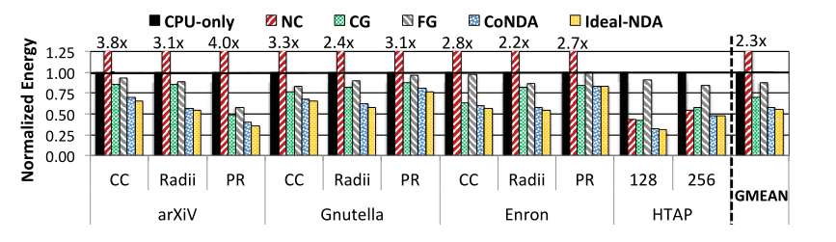
Research work—Evaluation
Memory System Energy.
(1) CoNDA reduces energy consumption over all prior mechanisms, by 18.0% on average over the best mechanism for memory system energy (CG).
(2) CoNDA achieves nearly all of the energy reduction potential of Ideal-NDA, coming within 4.4%, and reduces energy consumption by 43.7% over CPU-only.

Slide 29
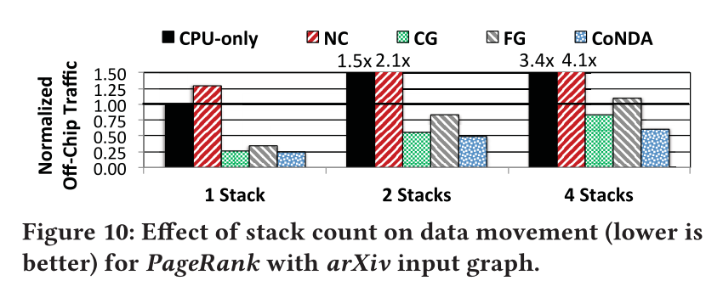
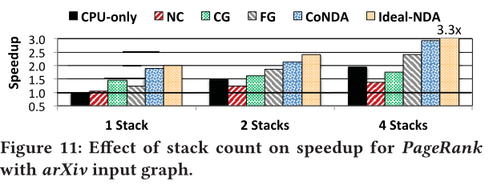
Research work—Evaluation
Off-Chip Data Movement.
Multiple Memory Stacks.
There are four CPU cores and four NDAs per stack, and that stacks are connected together using the processor-centric. Topology.
Off-chip Traffic and performance

Slide 30
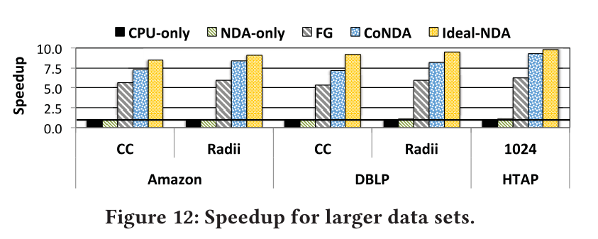
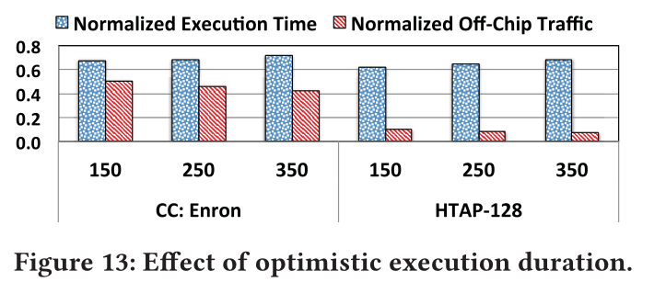
Research work—Evaluation
Effect of larger Data Sets.
Increasing the data set size significantly increases the benefits of CoNDA, because the larger data sets result in a significantly larger number of cache misses than the smaller data sets.
CoNDA improves performance by 8.4x over CPU-only, 7.7x over NDA-only, and 38.3% over FG.
Effect of Optimistic Execution Duration.
As the duration increases from 150 addresses to 350 addresses, the total execution time increases by 5.7% and 10.5% for Connected Components and HTAP-128.
As the duration increases, the off-chip traffic decreases, by 25.7% and 15.5%, respectively.

Slide 31
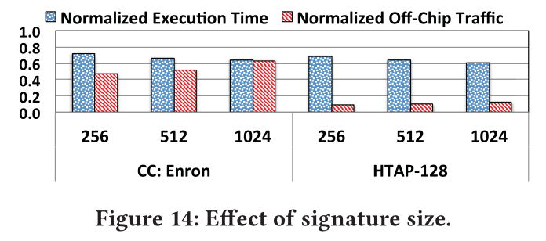
Research work—Evaluation
Effect of Signature Size.
The signature size increases from 256 B to 1 k B, the execution time decreases by 10.1% for Connected Components and 10.9% for HTAP-128.
The signature size increases from 256 B to 512 B and to 1 k B, the off-chip traffic increases, by 32.7% and 31.4%.

Slide 32
Research work—Evaluation
Effect of Data Sharing Characteristics.
Limited sharing.
(1) CG, NC, and CoNDA all perform comparably, outperforming CPU-only by 1.83x,1.85x, and 1.82x.
High amount of sharing, infrequent collisions.
High amount of sharing, frequent collisions.
(1) CoNDA performs only 2.1% worse than CPU-only, it still falls significantly short of Ideal-NDA, by 51.2%, due to frequent rollbacks.

